Slide 2
GEM
Fermentation
NaCl
Carbon sources
etc
ecGEM
Simulations
Proteomics
Calibrate: k_{cat}, etc
Bayesian Approach
https://www.biorxiv.org/content/10.1101/2020.04.01.019620v1.full

Slide 3
SMC-ABC curation of kcats

Slide 4
SMC-ABC curation of kcats---Reduced Uncertainties

Slide 5
SMC-ABC curation of kcats and omics

Slide 6
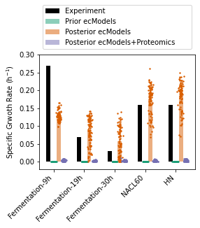
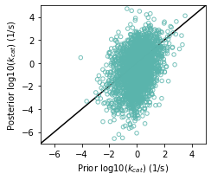
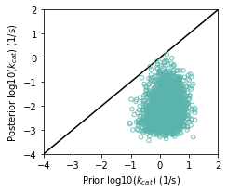
a
b
c
d
Posterior model parameter validation
Other simulations for ecModel validation/application
Notes:
Figure X Using proteomics to calibrate ecModel. (a) An illustration of calibration approach. (b) Simulated specific growth rate at various conditions. (cd) Parity plots of updated (c) mean and (d) standard variance of kcat values.

